Slide 1
Admin
🍩
Schedule change…
CMU
Kovach, Will Park, Kelly, Jo Park → new student survey
Shafer → Identity card form
Create CMU online account
For those looking to get ahead early… list of CMU certs and which ones you would like to complete (CMU will also consider alternates)
Scribe…

Slide 2
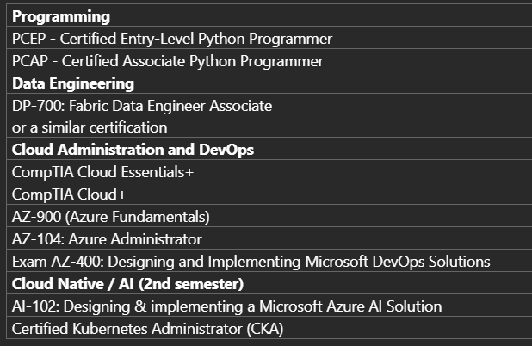
Certs
Pick one from each group

Slide 3
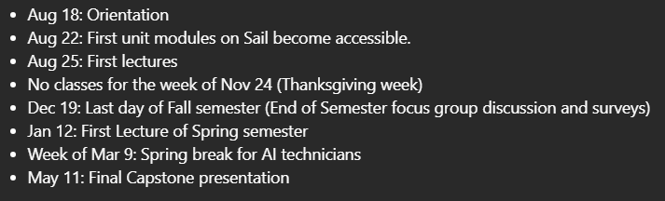
CMU timeline

Slide 4
Intro to Linux
AI2C Tech Intro

Slide 5
Objectives
Describe the purpose and role of an operating system
Examine key concepts of the Linux architecture
Navigate and manipulate the Linux filesystem using basic CLI commands

Slide 6
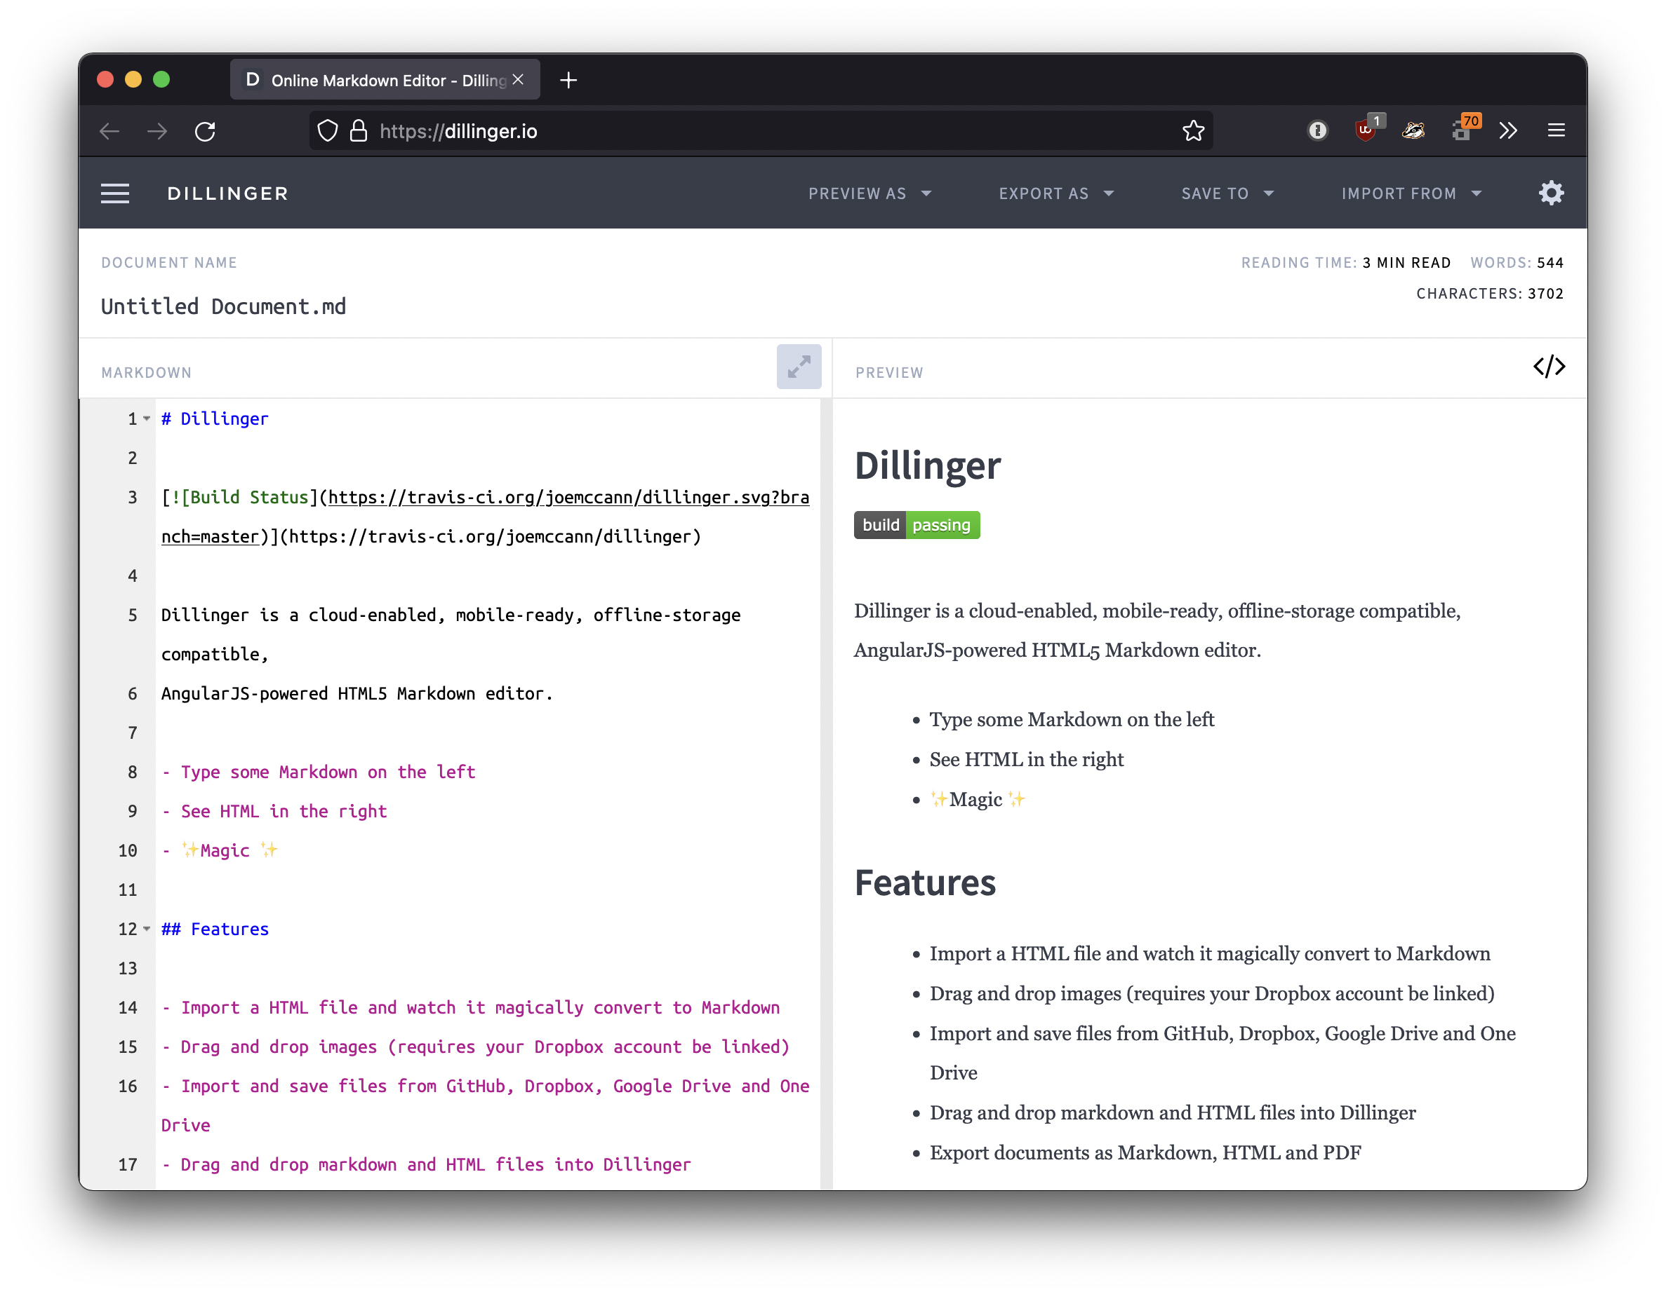
Side Quest
Markdown files¹
VS Code Extensions (markdown viewer, pdf reader)
Notes:
¹https://www.markdownguide.org/getting-started/

Slide 7
What is an operating system?

Slide 8
What are some Operating Systems that are out in the wild?

Slide 9

Linux
Meet Tux

Slide 10
Linux
What is it?
Common Distributions²
Family of operating systems
Based off Unix (an AT&T OS)
Designed to be compatible with Unix applications
Main kernel written by Linus Torvalds (famously ill-tempered opinionated)³
Open source and available freely¹
Debian / Ubuntu
Fedora
openSUSE
Arch
Gentoo
Alpine
Notes:
¹ https://git.kernel.org/pub/scm/linux/kernel/git/torvalds/linux.git/
² https://en.wikipedia.org/wiki/Linux_distribution#Widely_used_GNU-based_or_GNU-compatible_distributions
³ https://github.com/corollari/linusrants

Slide 11
Windows Subsystem for Linux

Slide 12
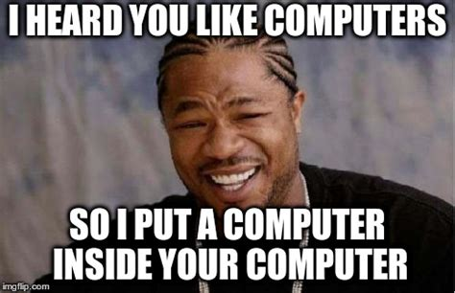
Actually, wait…
Virtual machines…
A “fake” OS inside another OS
The “host” OS presents virtual (fake) devices to the “guest” OS
Remember, everything is just interpreted 1s and 0s
Mice, keyboards, etc, are all just 1s and 0s.
We’ll talk more about it in the cloud lessons

Slide 13
Windows Subsystem for Linux
A Linux VM running as a guest on a Windows host
That Linux VM hosts “containers” for each distribution
The Windows filesystem is mounted into the Linux filesystem

Slide 14
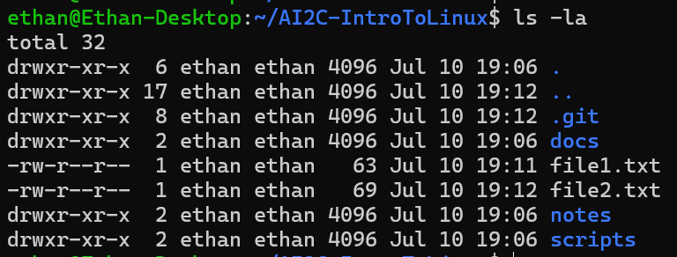
Filesystems
A filesystem is a system that handles files… (and folders)
OS’s provide a variety of utilities to manage the filesystem
Notes:
Go in-depth on the output of the –la command
Ls – command
-la – arguments / flags
Total 32 – number of blocks used by this tree
First column - dir/file, owner, group, others permissions
Second column – number of hardlinks
Third column – owner
Fourth column – group
Fifth column – space taken by file (metadata for directories)
Sixth(ish) columns – last modified time
Last column – file/directory name

Slide 15
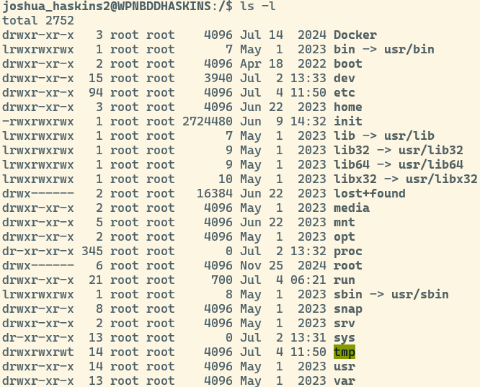
The Linux File System
Everything starts at a single root /
No drive letter
Common layout
/bin
/etc
/home
/var
Forward slashes
File extensions NOT required!!!
File names are case sensitive and should not contain spaces…

Slide 16
Paths – Absolute
Absolute Path
Specifies every directory that needs to be traversed (double clicked) to access a particular location
Assumes you are starting from the very top / beginning
C:\users\cadet.snuffy\courses\cy355\lesson_slides\lesson_04

Slide 17
Paths – Relative
Relative Path
A relative path assumes you are already somewhere in the file system
Provides instructions from your current location to your destination
You are currently in C:\users\soldier.joe\courses\AI400 and want to get to today’s lesson slides located at
C:\users\soldier.joe\courses\cy355\lesson_slides\lesson_04
Assuming AI600 is also in C:\users\soldier.joe\courses, what is the relative path?
..\AI600\lesson_slides\lesson_04

Slide 18
Filesystem Operations
Command | Description
pwd | Print working directory
cd | Change directory (equivalent of double-clicking a folder)
ls | List contents of a directory (-l for detailed view, -a for all files)
cp | Copy a file or directory (like "copy and paste")
mv | Move or rename a file/directory (like "cut and paste")
touch | Update timestamp or create a new file
mkdir | Create a new directory
rm | Remove a file
cat | Print the contents of a file to the terminal
Notes:
* These commands are destructive in that there is no going back. If you delete a file it is gone. If you overwrite a file, that file is gone.

Slide 19
Hands-On #1
Terminal overview
Filesystem commands

Slide 20
Other common utilities
grep
wc
ssh
|, >, >>, <, &&, ||

Slide 21
Finding help…
Often, `command --help`
Other times, `man command`
“Manual pages” -> “manpages” -> “man”
Of course:
Documentation
Stackoverflow
Reddit
Chatgpt
Google

Slide 22
Regular Expressions
If you want to learn more about grep patterns…
Regular expression syntax cheat sheet - JavaScript | MDN
regex101: build, test, and debug regex
Top 15 Commonly Used Regex - Digital Fortress

Slide 23
Hands-On #2
Use the discussed utilities on a Linux system

Slide 24
How are you feeling?

Slide 25
Useful Commands
history – linux command history

